Slide 1
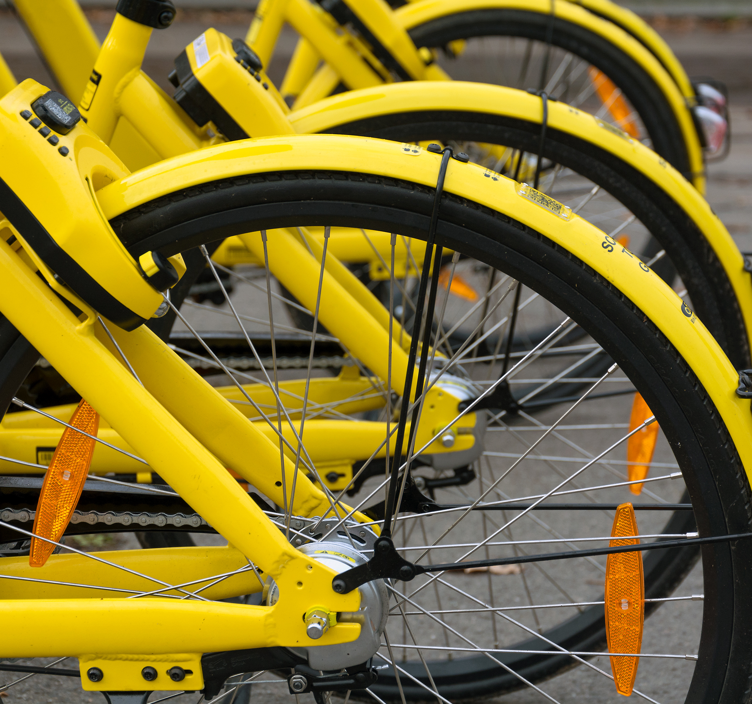
Seoul Bike Sharing
Group Epsilon:
Ryan Goebel, Nicole Castonguay, Brad Viles, and Tim Przybylowicz
Northeastern University ALY 6015.23546
February 22, 2021

Slide 2

Introduction

Slide 3

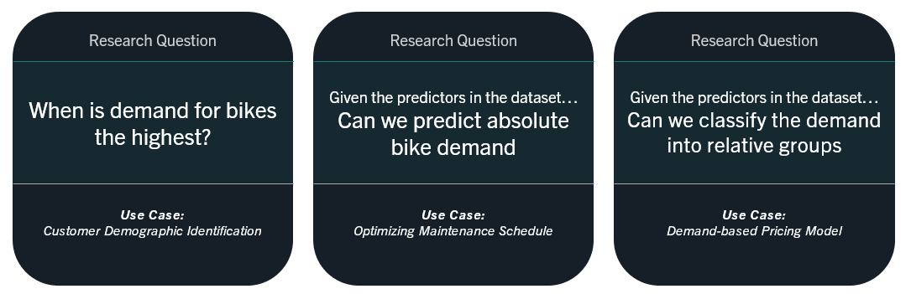
Research Questions

Slide 4

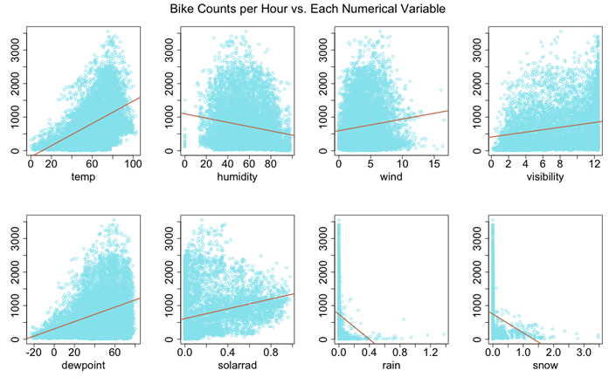
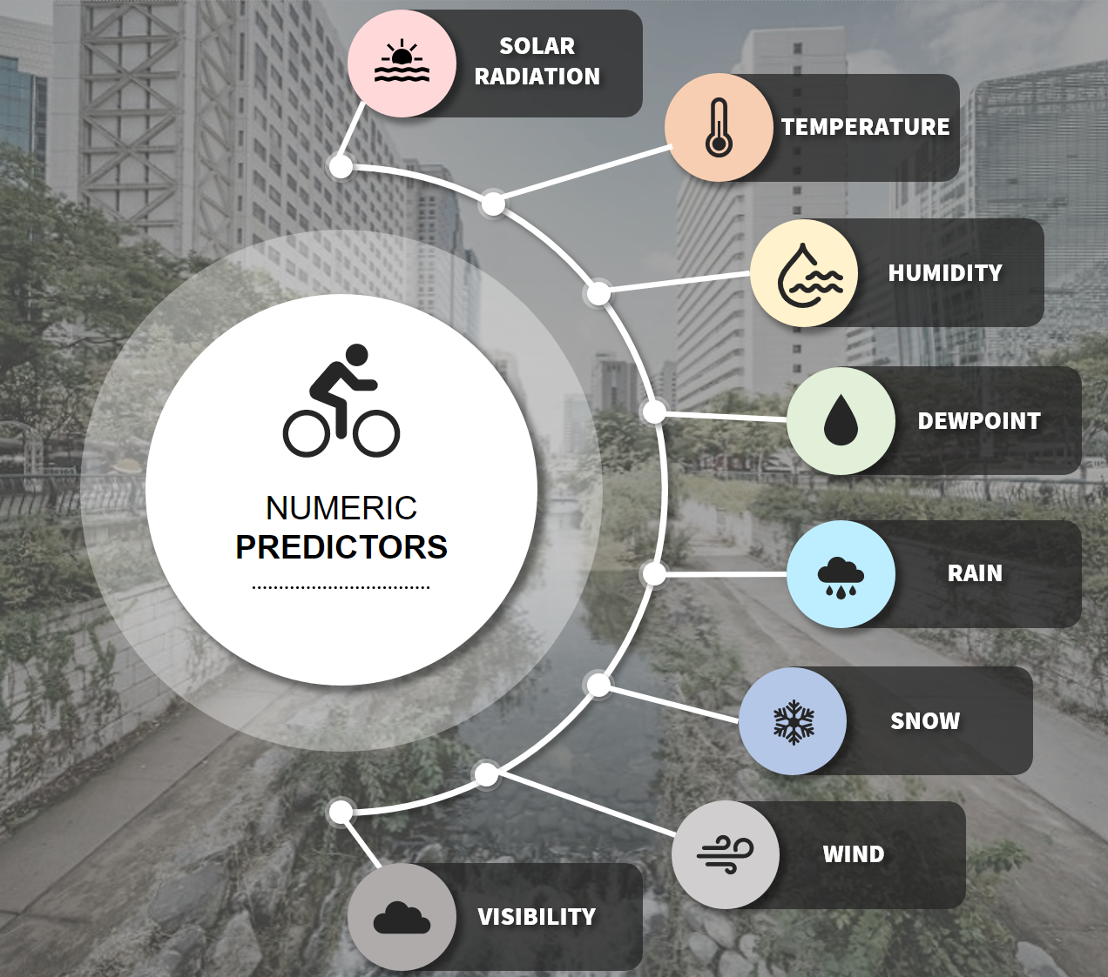
DATA SET NUMERIC VARIABLES
Notes:
Our data set contains one year of bike share data spanning from December 2017 to November 2018
Our dependent variable is the # of bikes being used
12 predictor variables in our dataset
4 categorical variables
8 numeric variables
Started with some descriptive statistics to really get a deeper understanding our data. Here are a couple examples of when the bikes are being used
Plotted demand by season, day of week, time of day, and holiday vs. Non holiday.
Right off the bat we observed a couple of things
Lower demand in the winter
Higher demand during commuting hours
This led us to wonder if the bikes were being used mostly for work purposes or for leisure?
Looking at the box plot of demand on each day of the week land it isn't clear if demand is different on the weekend, so we performed a hypothesis test

Slide 5
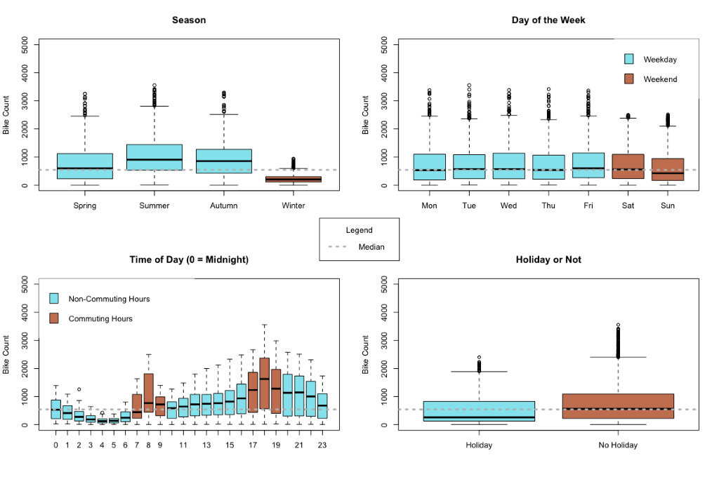
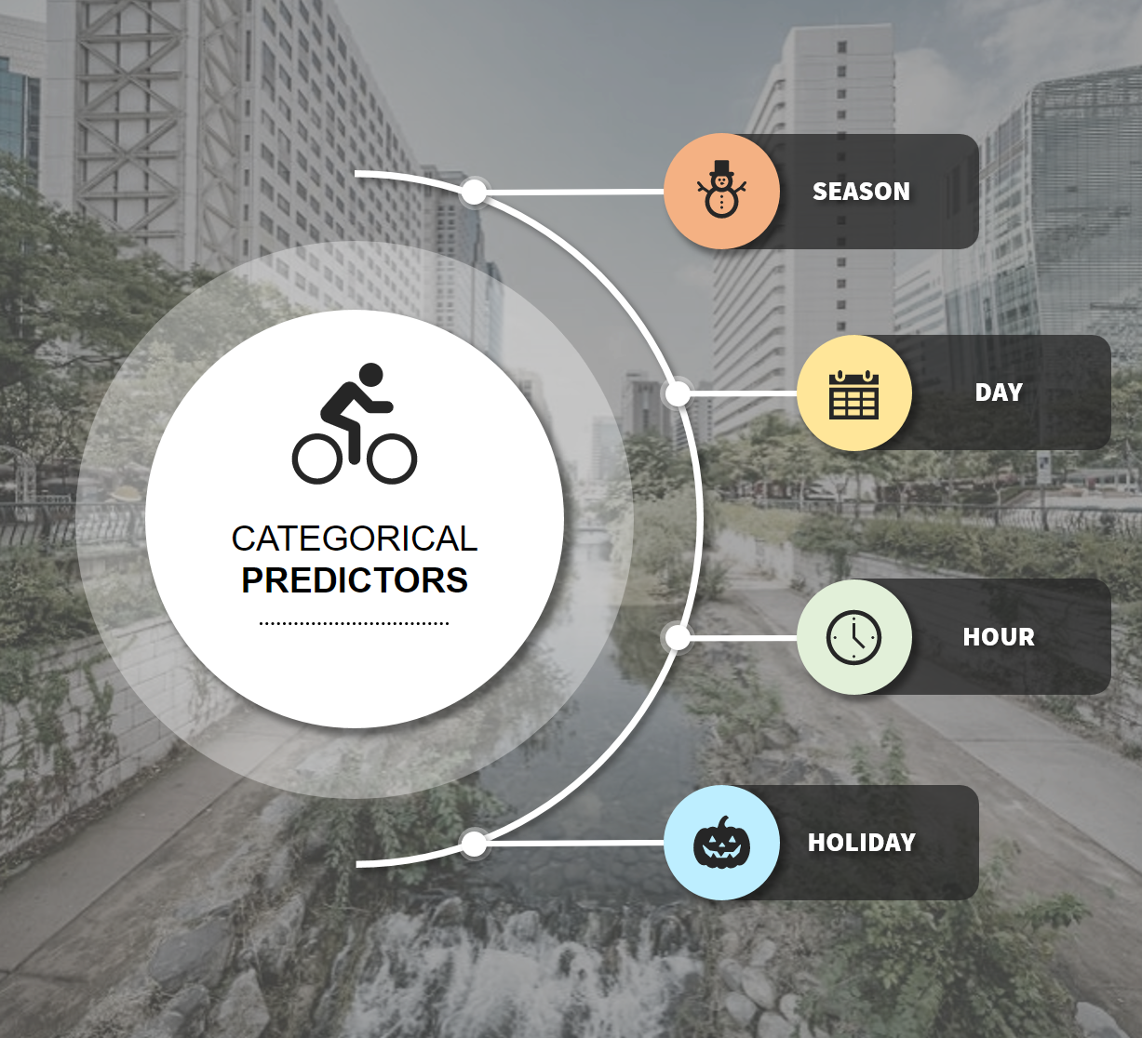
DATA SET CATEGORICAL VARIABLES
Notes:
Our data set contains one year of bike share data spanning from December 2017 to November 2018
Our dependent variable is the # of bikes being used
12 predictor variables in our dataset
4 categorical variables
8 numeric variables
Started with some descriptive statistics to really get a deeper understanding our data. Here are a couple examples of when the bikes are being used
Plotted demand by season, day of week, time of day, and holiday vs. Non holiday.
Right off the bat we observed a couple of things
Lower demand in the winter
Higher demand during commuting hours
This led us to wonder if the bikes were being used mostly for work purposes or for leisure?
Looking at the box plot of demand on each day of the week land it isn't clear if demand is different on the weekend, so we performed a hypothesis test

Slide 6

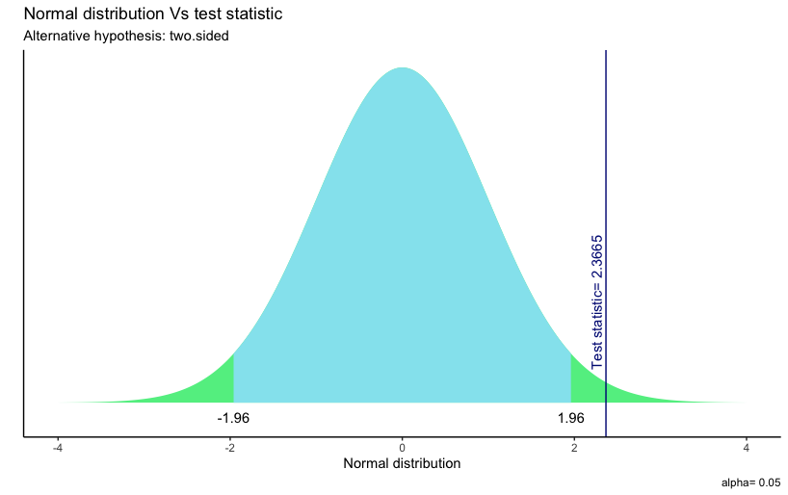
Hypothesis testing
H0:
Mean weekday demand = Mean weekend demand
HA:
Mean weekday demand ≠ Mean weekend demand
_________________________________________________
First checked for normality and equal variances
Null hypothesis rejected at 95% confidence
Different levels of demand on weekend vs. weekdays

Slide 7

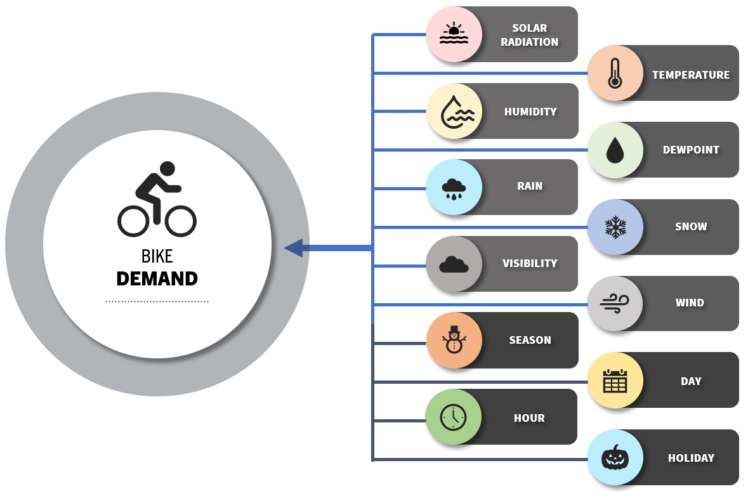
Regression models

Slide 8
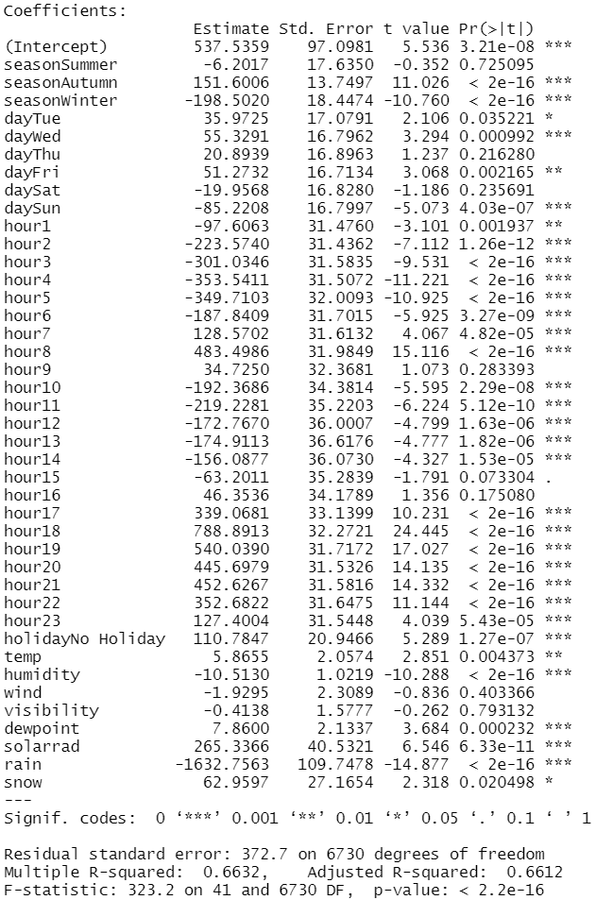
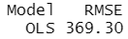






Regression models Ordinary Least Squares MODEL
Research Question: Predicting absolute bike demand.
MODEL PERFORMANCE:
Most Correlated Variables | LEAST Correlated Variables

Slide 9
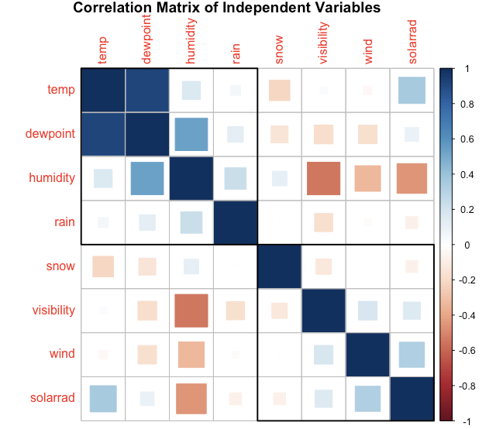
Regression models DEALING WITH MULTI-COLINEARITY
Research Question: Predicting absolute bike demand.
Significant relationships between independent variables can introduce inaccuracies in an ordinary least squares model.
Potential relationships within our independent variables:
Temperature and Dewpoint Temperature (Positive)
Dewpoint Temperature and Humidity (Positive)
Humidity and Visibility (Negative)
Regularization Techniques help mitigate these inaccuracies
Note: Categorical variables not shown in correlogram

Slide 10
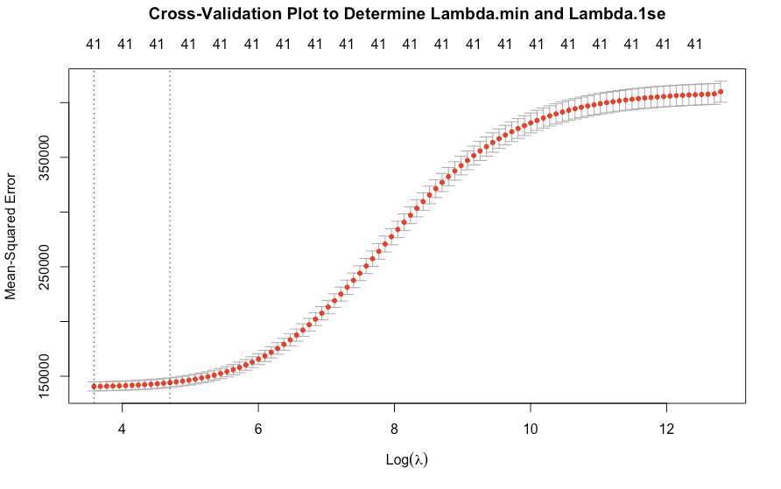
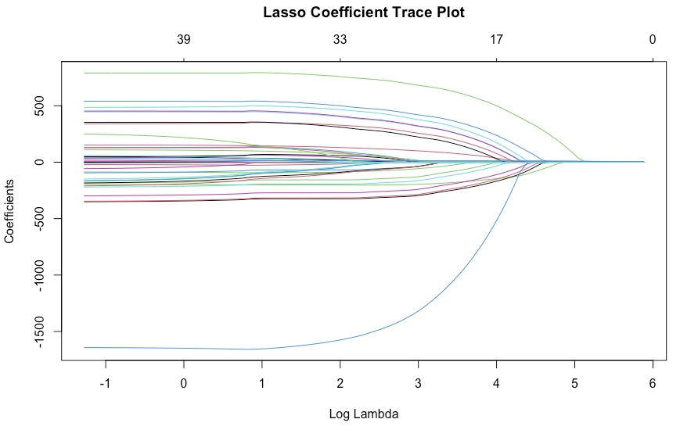
Regression models Regularization techniques
Research Question: Predicting absolute bike demand.
Regularization was brought in to mitigate the risk of using correlated independent variables.
Ridge limits coefficient magnitudes via a penalty term
Lasso limits number of predictors via a penalty term
Elastic Net mixes ridge and lasso penalties for optimization.
Methodology:
Create Model (Training Data)
Alpha derivation (if necessary)
Lambda (tuning factor) derivation
Predict Results (Test Data)
Compare Predicted Values to Actual Values

Slide 11
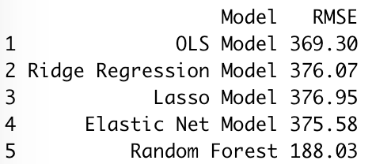
Regression models Regularization RESULTS
Research Question: Predicting absolute bike demand.
In predicting bike demand:
OLS outperformed each of the different regularization models.
Potential Driver:
Number of Observations >> Number of Predictors

Slide 12
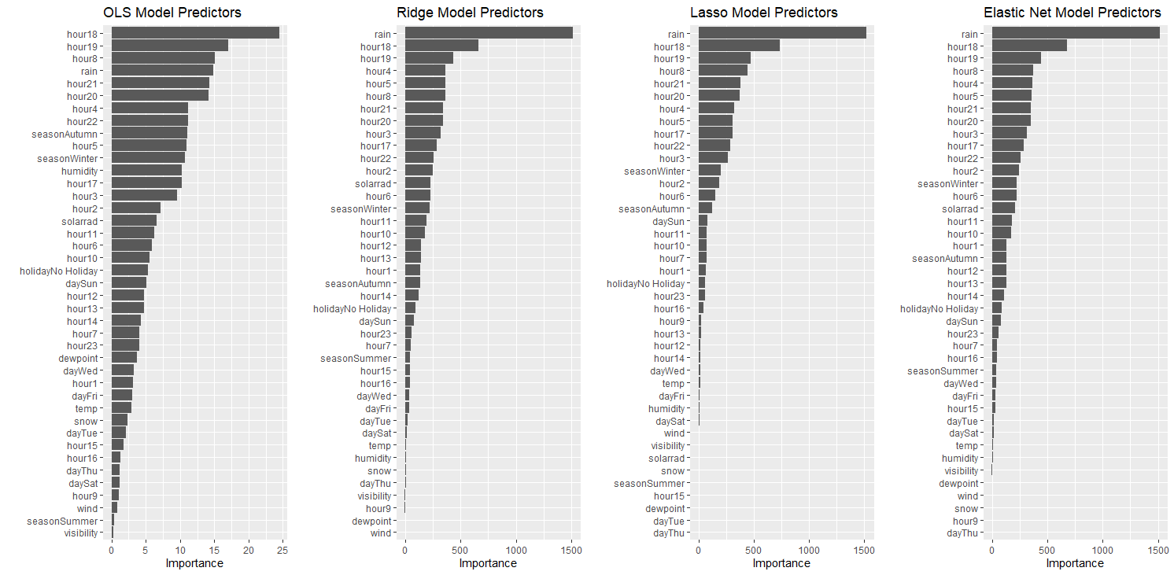
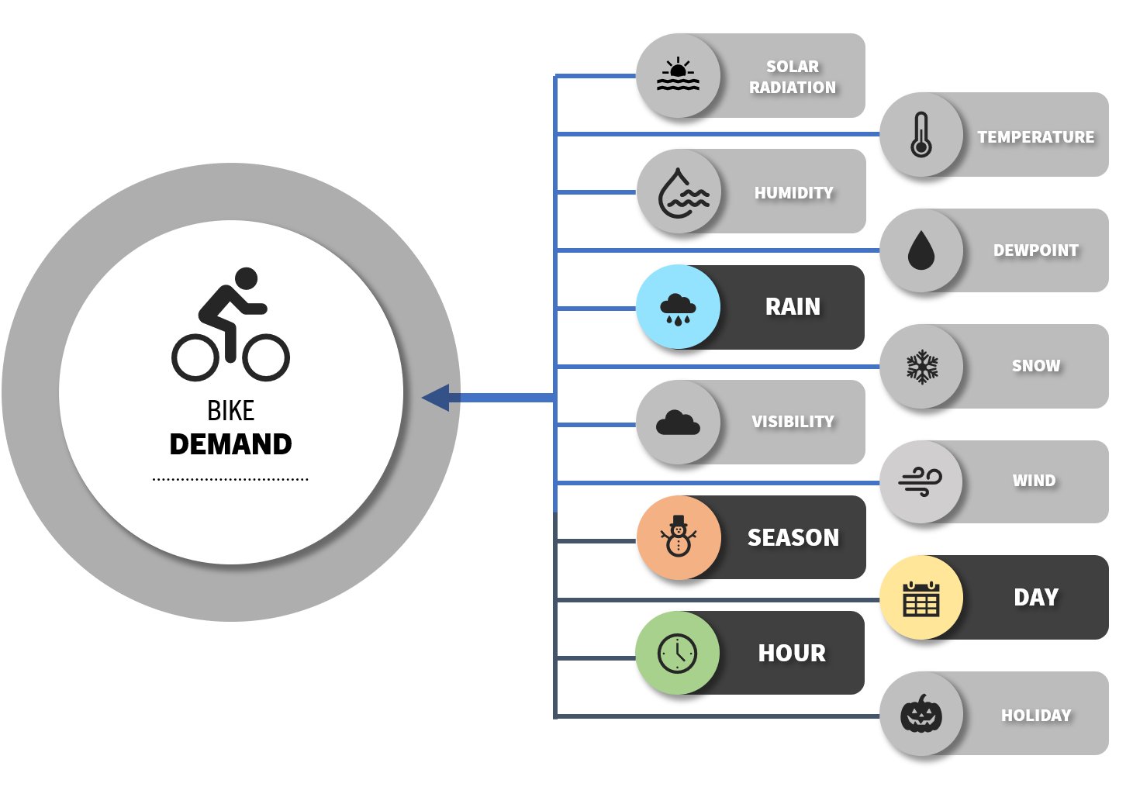
Regression models Regularization RESULTS
Research Question: Predicting absolute bike demand.

Slide 13
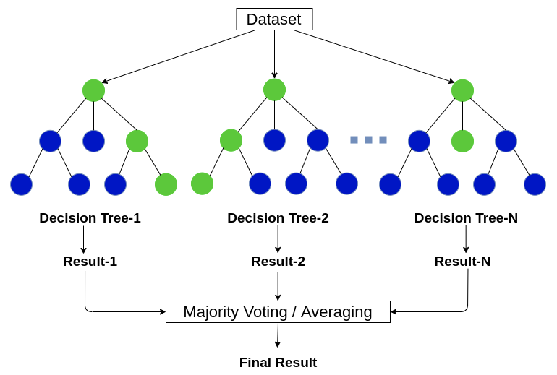
Random forest
A forest of decision trees with randomly selected predictor variables
Training data is bagged (Bootstrap AGGregatED)
Trees are de-correlated, variance reduced
Regression or classification
Image from: https://www.analyticsvidhya.com/blog/2020/05/decision-tree-vs-random-forest-algorithm/

Slide 14
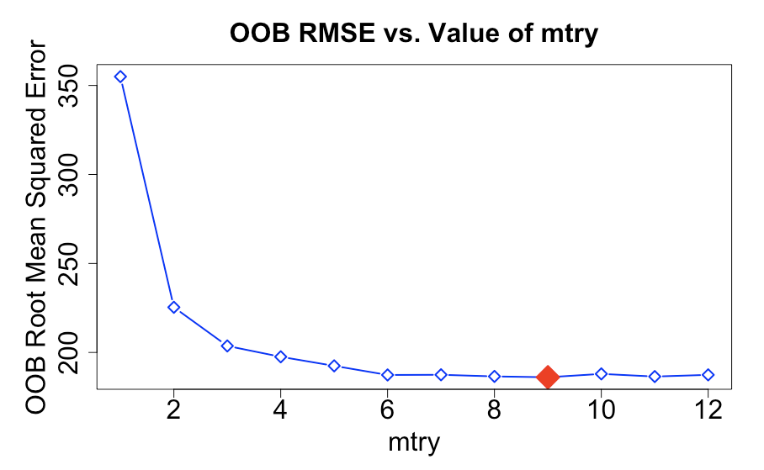
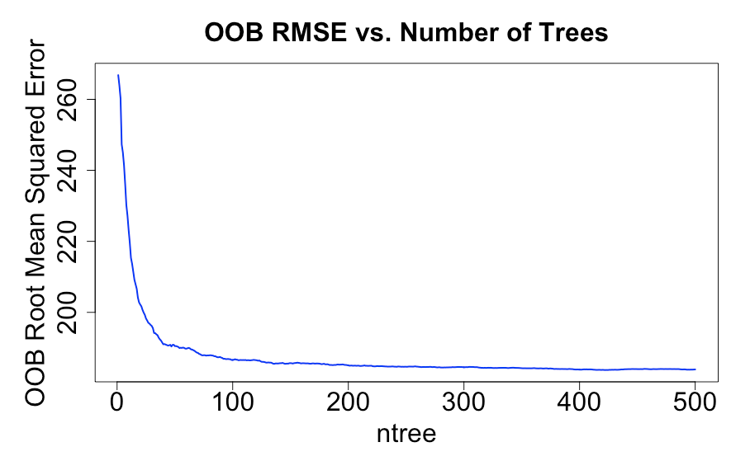
Random forest Regression model
Choose optimal mtry variable
Verify sufficient ntree variable

Slide 15
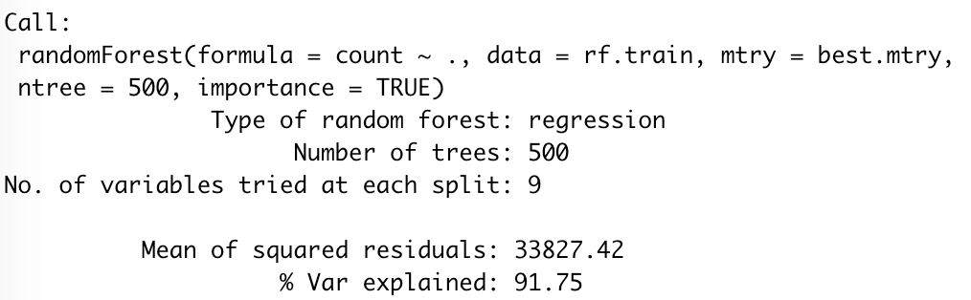
Random forest regression model results
Model Description
Performance on OOB data
Model has out-of-bag MSE of 33827.42 (RMSE 183.92)
Applying the model to the testing data results in an RMSE of 188.03

Slide 16
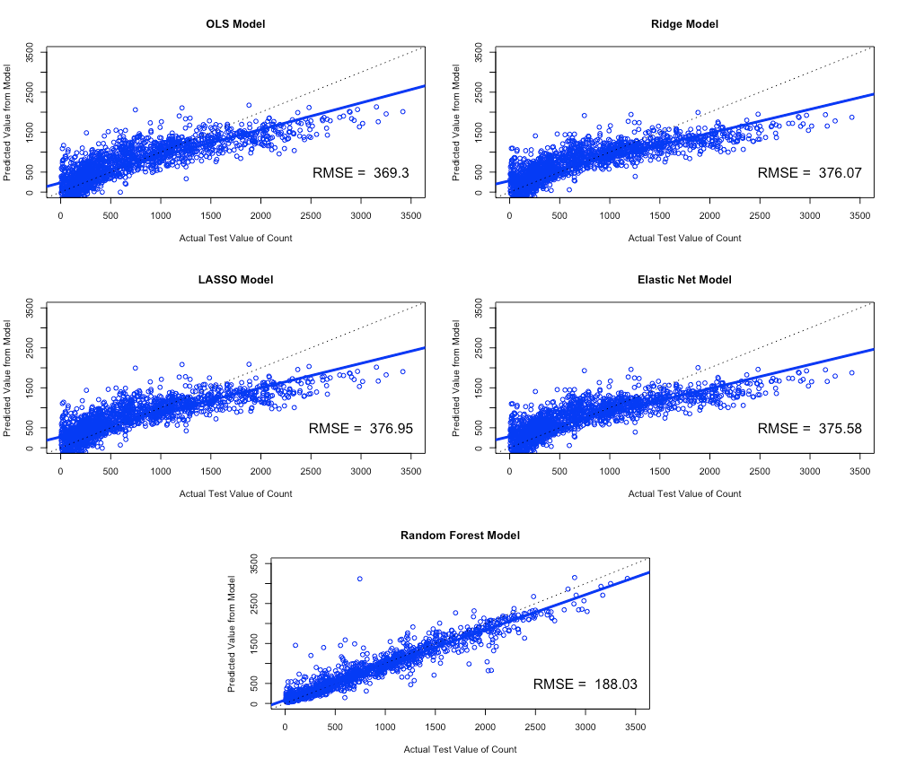
Regression models comparison

Slide 17

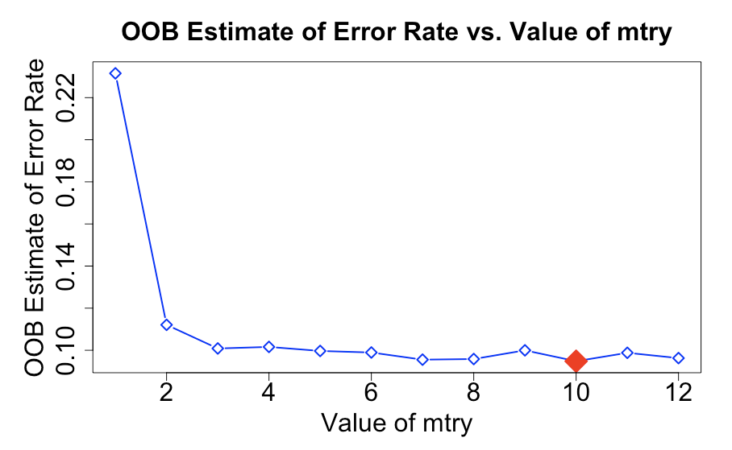
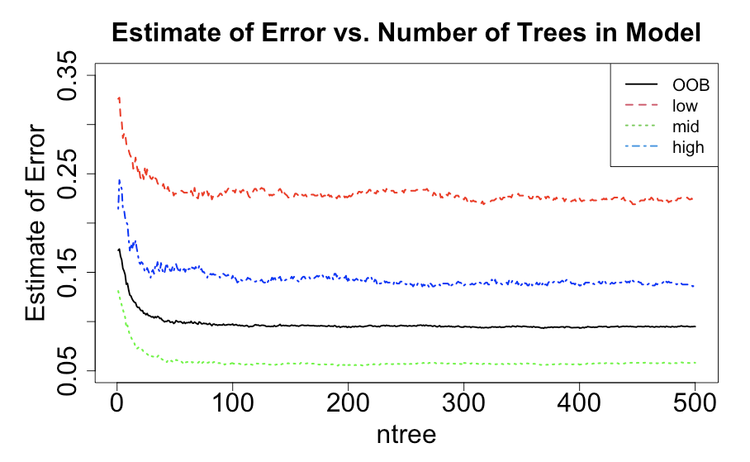
Random forest Classification model
Classes / Categories
Low Demand: Bottom 15% ( < 137 bikes/hr)
Mid Demand
High Demand: Top 15% ( > 1424 bikes/hr)

Slide 18
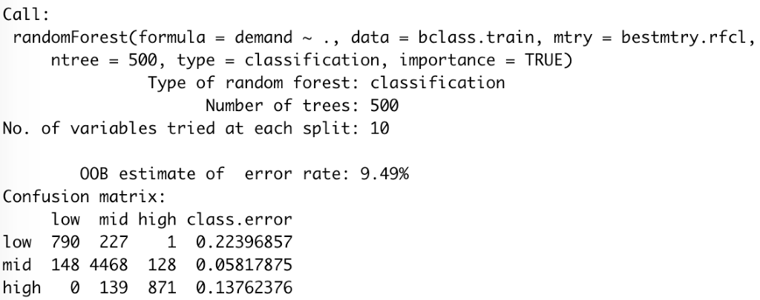
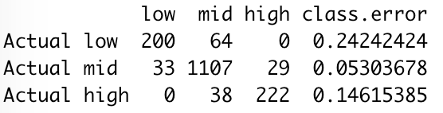
Random forest classification results
Model Description and OOB Error Estimate
When applied to testing data set:
Confusion Matrix

Slide 19
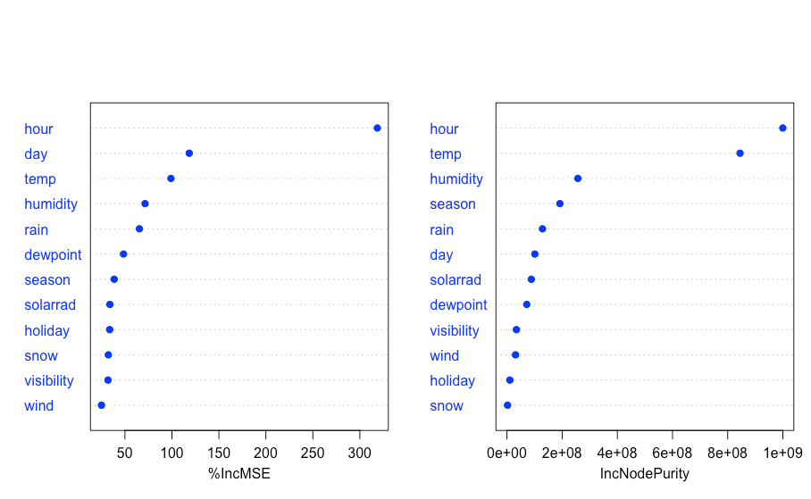
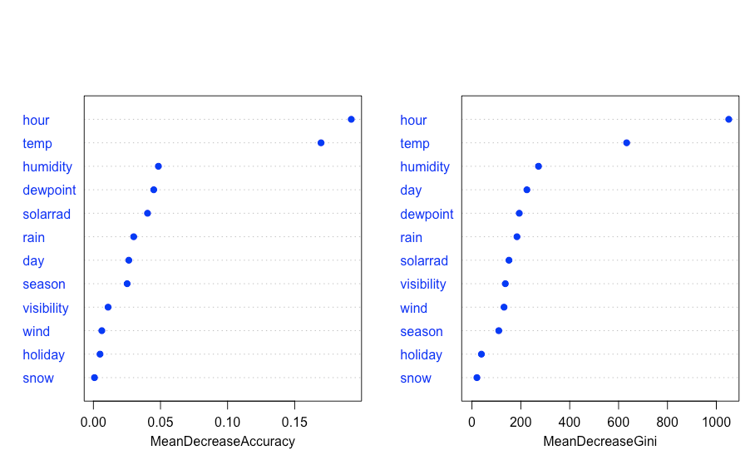


Random forest variable importance
RF Regression Model
RF Classification Model
The hour and temp variables have largest impact overall

Slide 20

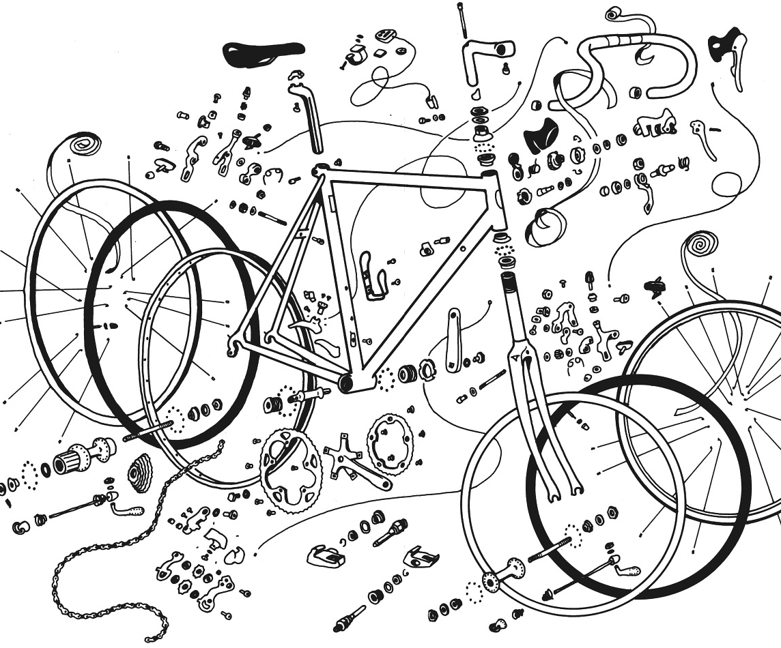
Business recommendations
Demand-based pricing
Commuter passes
Optimized maintenance

Slide 21
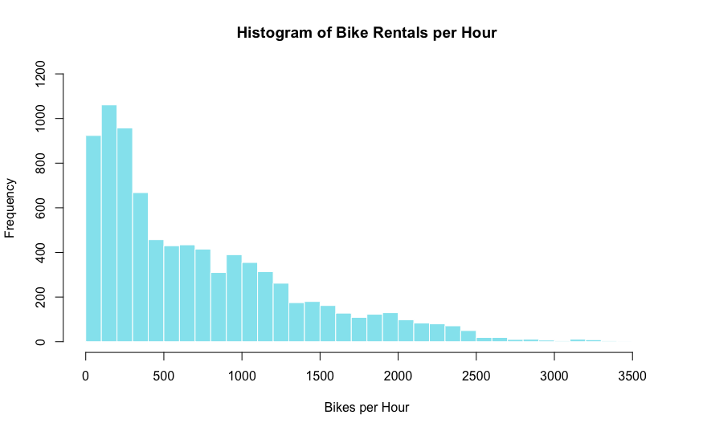

Opportunities for further analysis
Follow-up on commuter population
Location tracking
Improved fleet efficiency
Greater model tuning
Time series analysis given more data collection

Slide 22
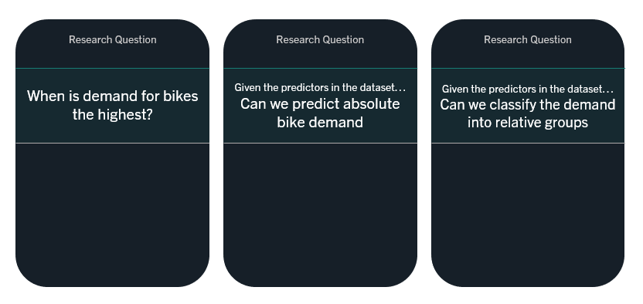
Conclusions

Slide 23

Thank you

